Slide 1
PPOL 628: Text as Data – Computational Linguistics for Social Scientists
Class 11: Topic Model Extensions and Validation

Slide 2
Today
Lecture: Extensions, Evaluation and Validation.
The structural topic model (STM) as a natural extension of LDA.
Advice and metrics to assess performance.
Validation strategies.
Lab: topic_models_2.R
Website: github.com/matthewjdenny/PPOL_628_Text_As_Data

Slide 3
The Structural Topic Model (STM)
When social scientists first began to use topic models, they would often take inferred document topic proportions, topic top-words, etc. and look at their relationship to document level covariates.
STM is a model that combines both parts of this process into a single model.
Better description of generative process, more complex inference.
Many papers (which I screenshot from liberally in these slides):
First Paper: https://scholar.princeton.edu/files/bstewart/files/stmnips2013.pdf
Derivation: https://scholar.princeton.edu/sites/default/files/bstewart/files/ajpsappendix.pdf
Paper we read for class: Roberts et al. (2014). Structural topic models for open-ended survey responses.
Package Vignette: https://cran.r-project.org/web/packages/stm/vignettes/stmVignette.pdf
Slides: http://ica-cm.org/wp-content/uploads/2017/05/roberts_topicmodels_combo.pdf

Slide 4
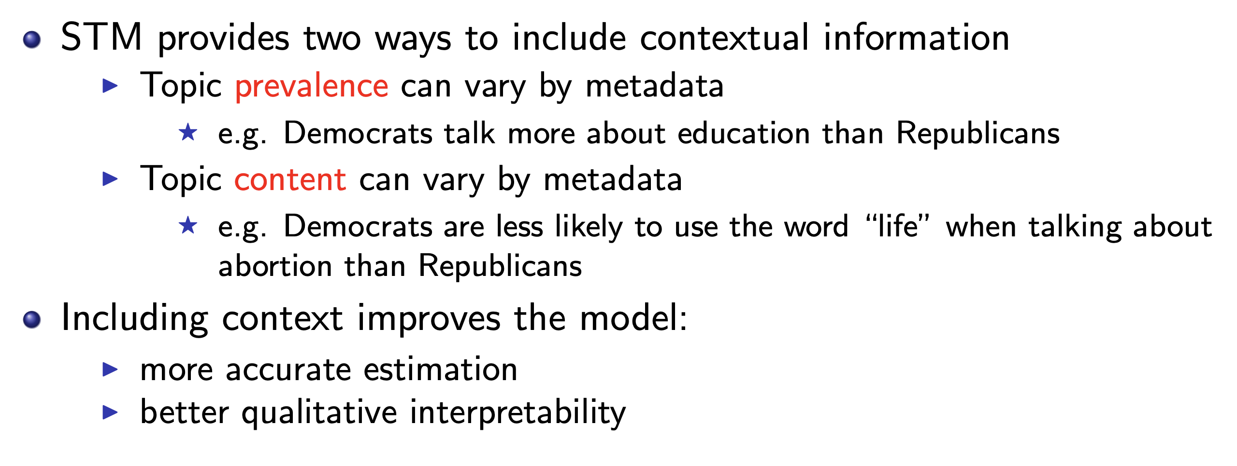
The Structural Topic Model
Built on top of LDA, but allows us to incorporate document-covariates into model.

Slide 5
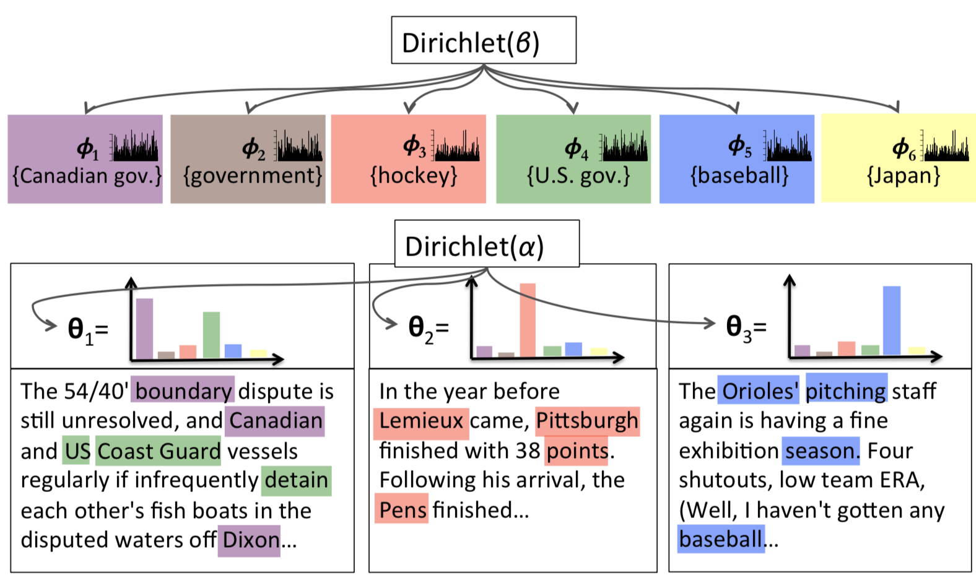
LDA Generative Process

Slide 6
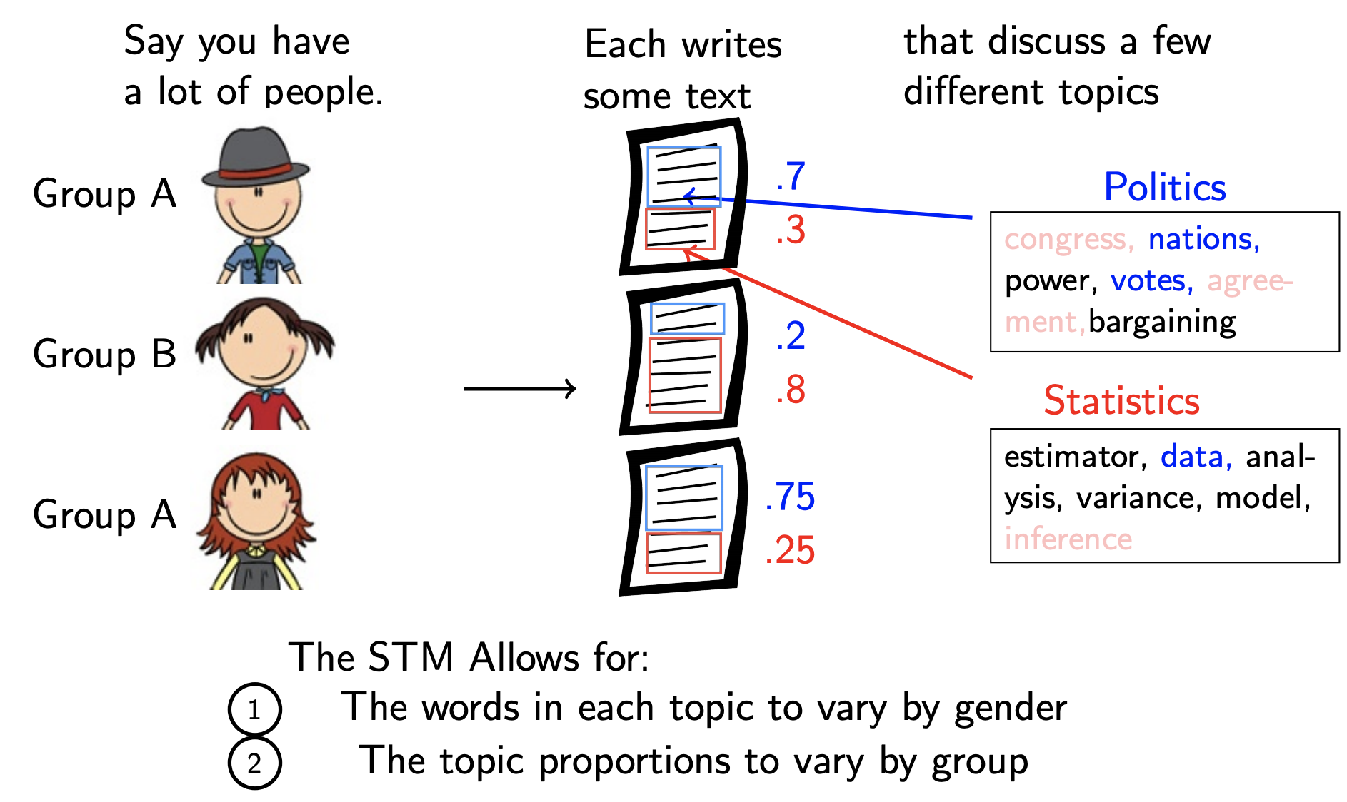
The Structural Topic Model

Slide 7
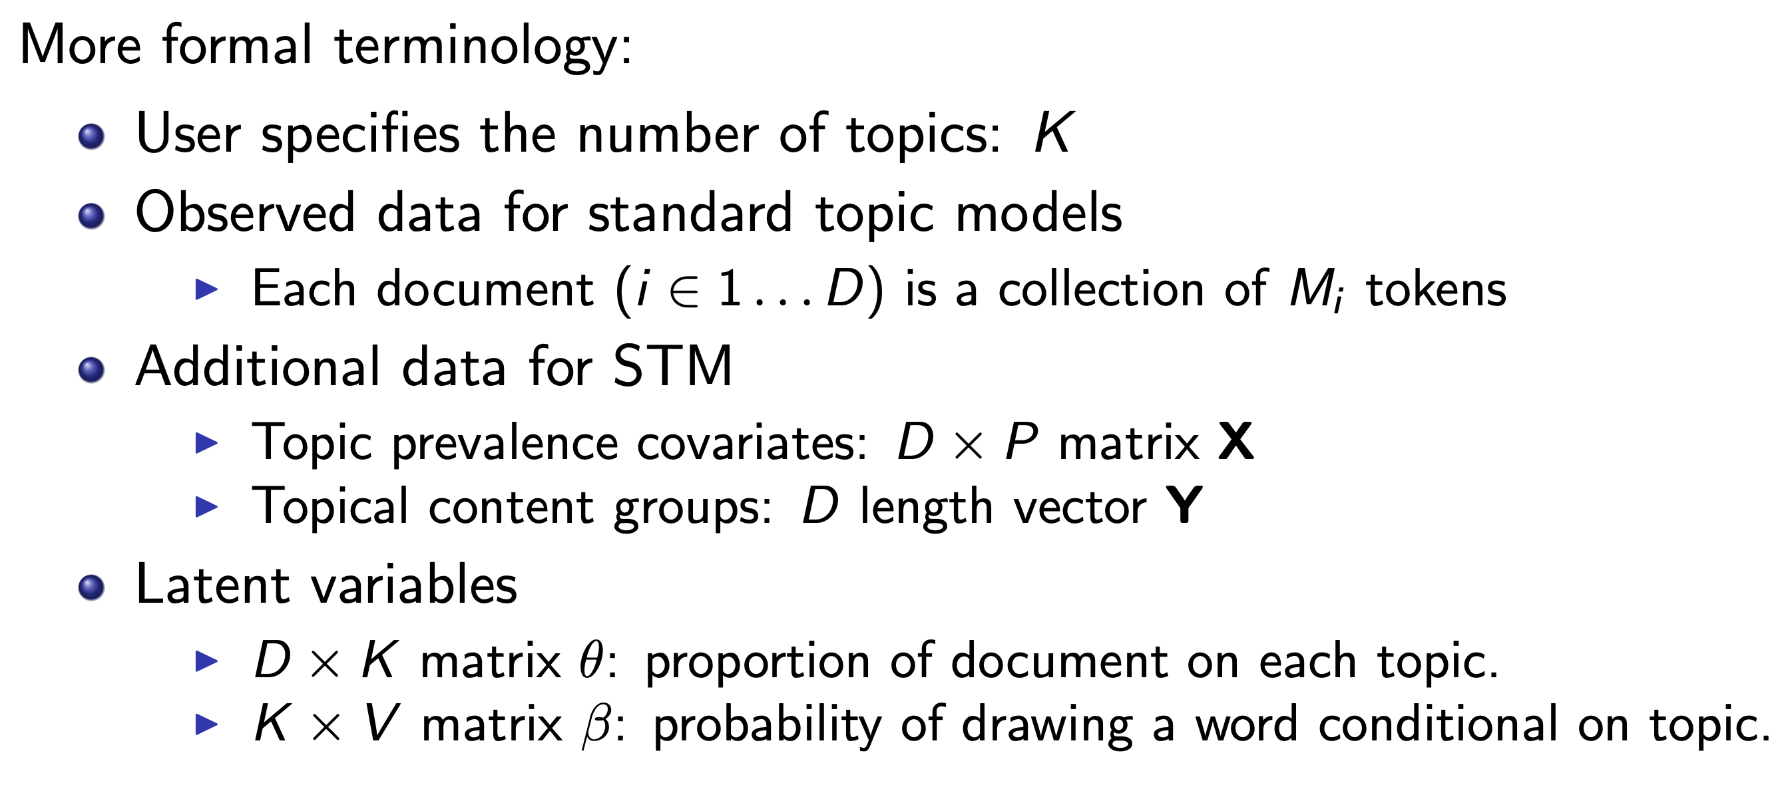
The Structural Topic Model

Slide 8
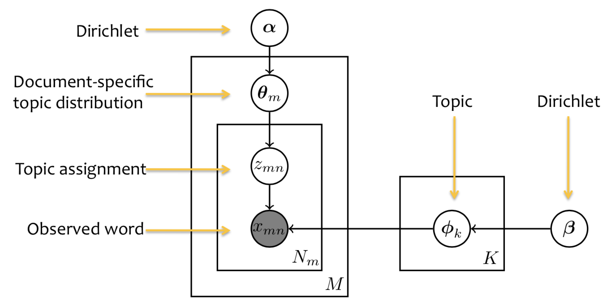
LDA Plate Model

Slide 9
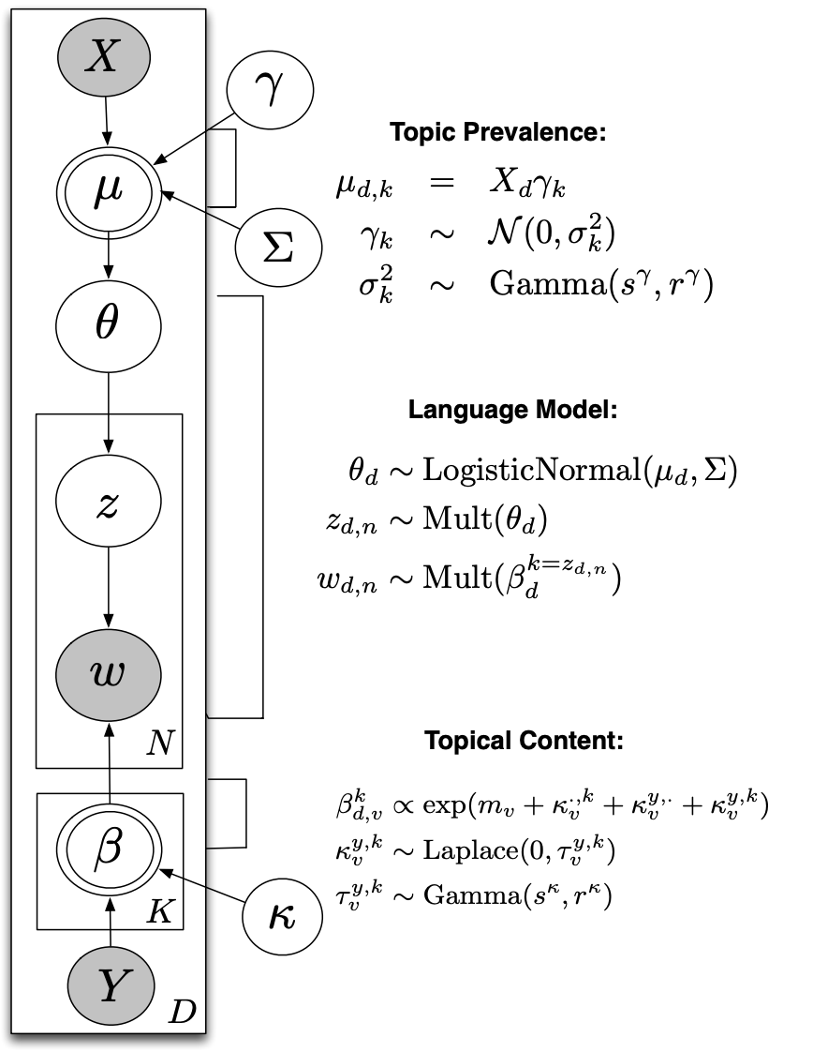
STM Plate Diagram
Logistic-normal GLM with covariates
“Normal LDA”
Multinomial Logit

Slide 10
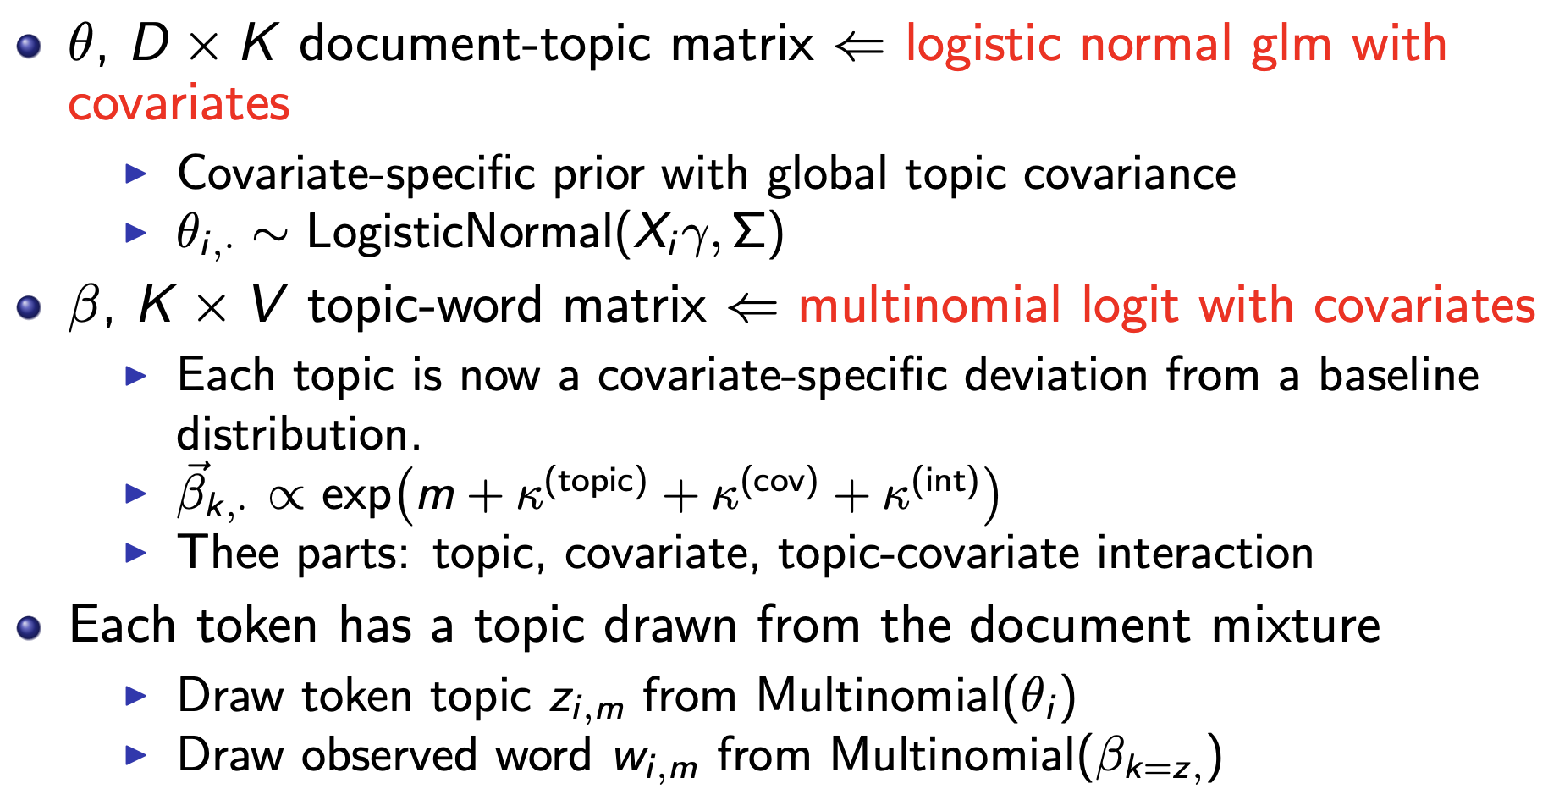
The Structural Topic Model

Slide 11
STM: Inference
General Approach: Same as LDA in that we want to “invert” the generative process we have posited for our model and use the data we observe to infer the latent variables that most likely generated our data.
Unlike LDA, where we can derive an elegant and relatively simple (collapsed) Gibbs sampler STM requires a more complex, approximate inference technique.
No longer have conjugate priors.
More expressive model ←→ more difficult inference.
Semi-collapsed variation expectation maximization.
Approximate true posteriors of interest to make inference feasible.

Slide 12
Semi-collapsed variational EM
Variational Approximation: take a distribution that is difficult to work with (intractable inference) and pick a distribution that behaves similarly but is easier to work with.
Expectation Maximization Algorithm:
E-Step: Find an approximation of the log likelihood function for your model, conditional on you data and current latent variable estimates.
M-Step: Maximize this approximation of the log likelihood function with respect to your latent variables.
Iteratively repeat these steps until convergence.
Semi-collapsed: Instead of changing one token-topic assignment at a time, update all of them for a document at once.

Slide 13
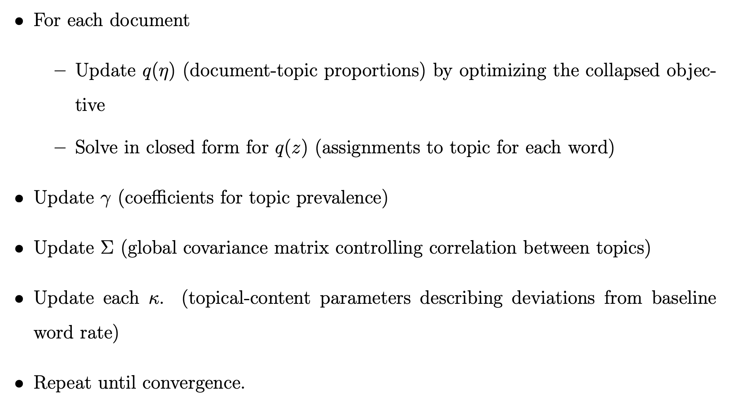
STM: semi-collapsed variational EM

Slide 14
STM: Overall Thoughts
Widely Used, Flexible Model, Highly Interpretable
If you care about how different authors use topics differently, how topics vary with covariates, etc. then you can neatly infer these relationships all at once.
Interpretability for document-covariate effects is just like a regression model.
Lots of nice built-in functionality in stm package for interpreting output.
Complex Model
Can have poor performance where model assumptions do not hold. Like vanilla LDA, still want a relatively large number of documents (thousands) to feel confident in inference.
Time and space complexity are high – not suitable for application to millions of documents with an extremely large vocabulary.

Slide 15
LDA Optimization and Validation
Hyper-parameter Optimization.
Selecting 𝛼 and 𝛽 -- let model choose.
Selecting number of topics – theory, let model choose (some applications).
Selecting number of iterations and assessing convergence (with Geweke test).
Assessing model performance
High quality topics? Cohesiveness, Exclusivity, FREX, Perplexity
Validation
Key point is to think about it, take steps to determine validity.
From Quinn et al. (2010) – Specification + Sensitivity Analysis, Reliability, Validity, Interpretability.

Slide 16
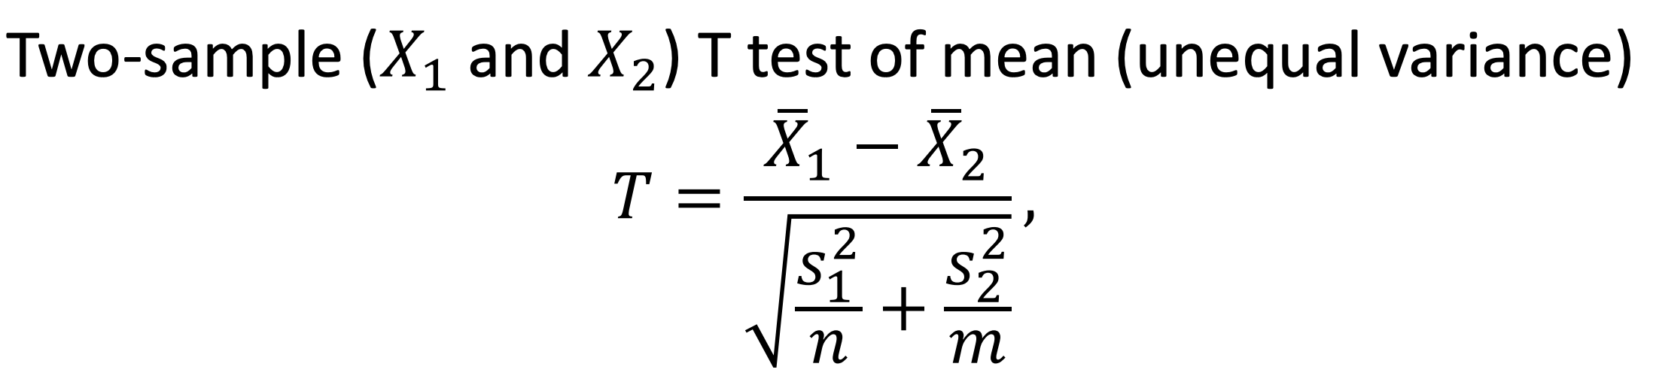
Geweke Test for Convergence of MCMC
Want to determine if we have reached the stationary distribution of our latent variables of interest.
Way to determine if we have selected an appropriate number of iterations for inference.
Geweke test compares the first 50% of samples (after burnin) to the last 10% and looks for a statistically significant difference.

Slide 17
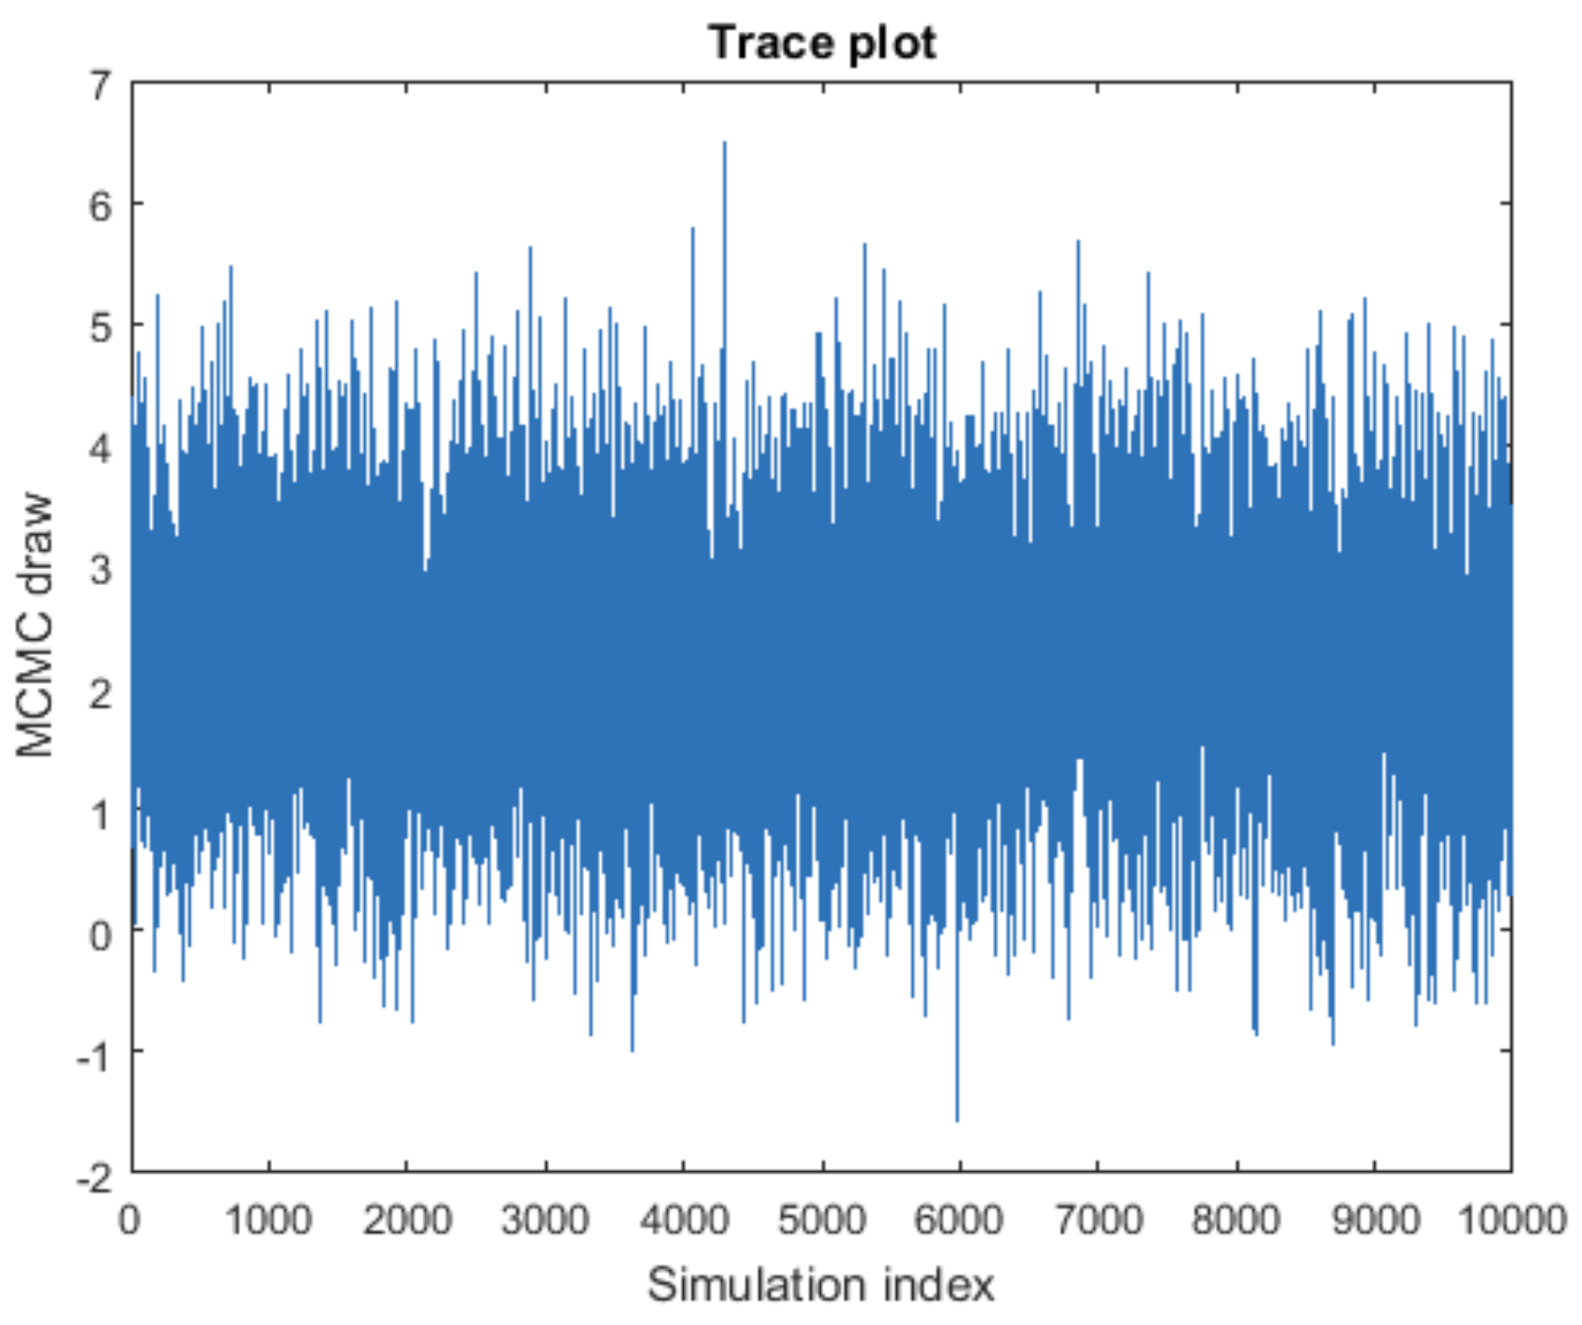
Goal: reach the stationary distribution

Slide 18
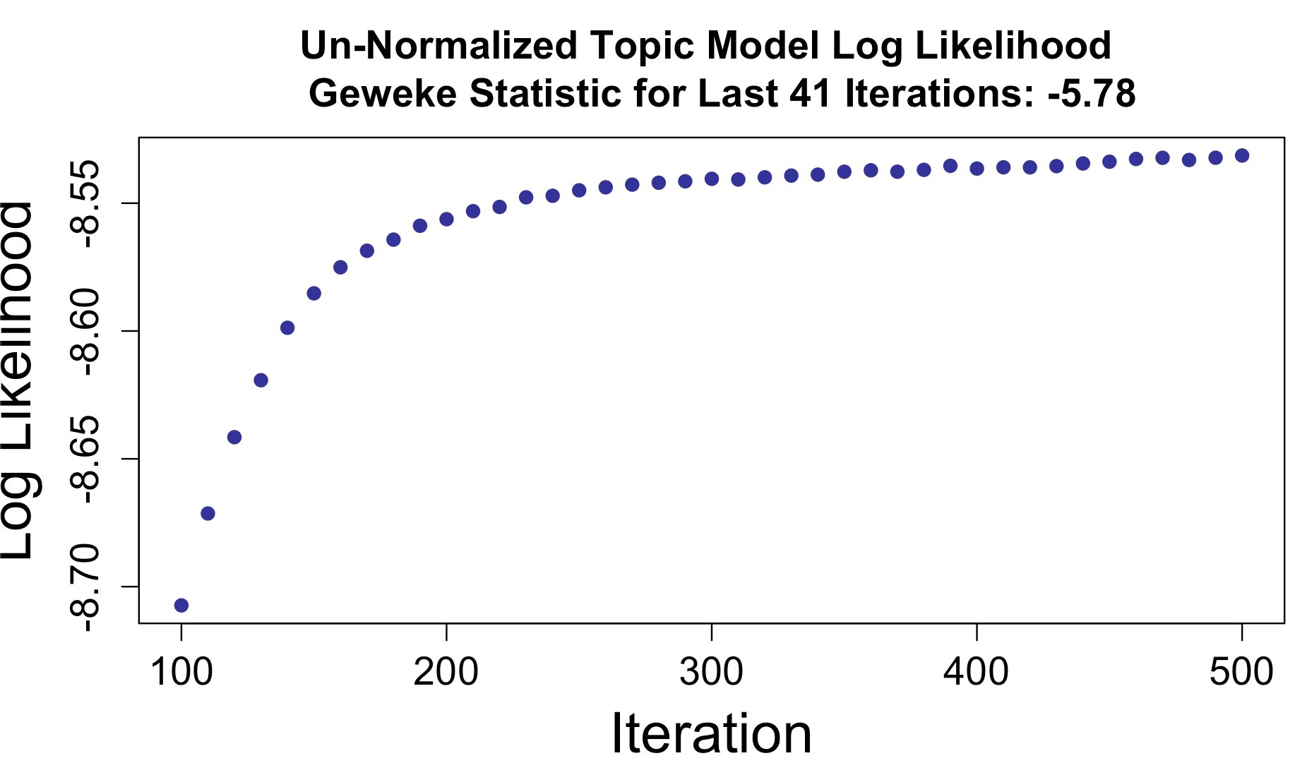
Model has not reached stationary distribution

Slide 19
Model has reached stationary distribution

Slide 20
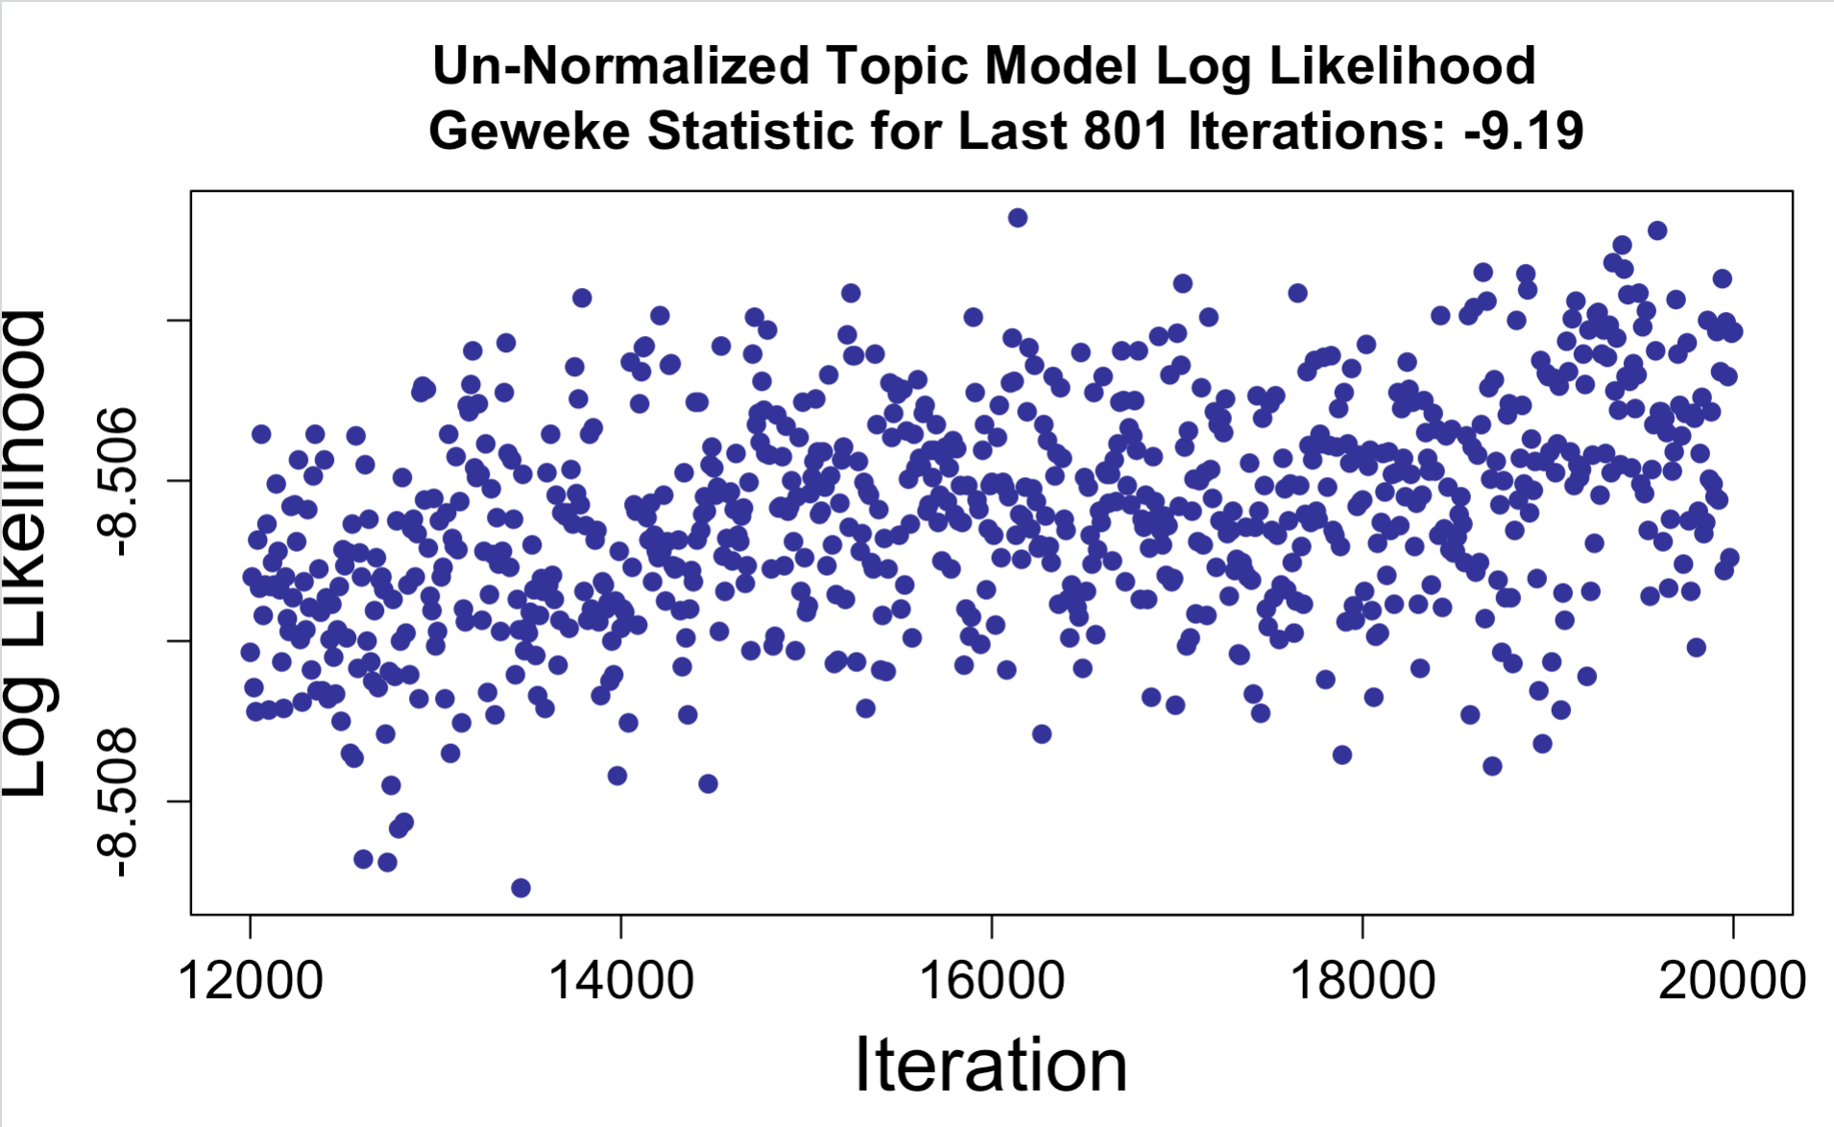
Geweke Statistic is not a Panacea
Same chain as last slide, different window, different conclusion.
Run model for longer than you think you need to, look at chain.
Experience is important.

Slide 21
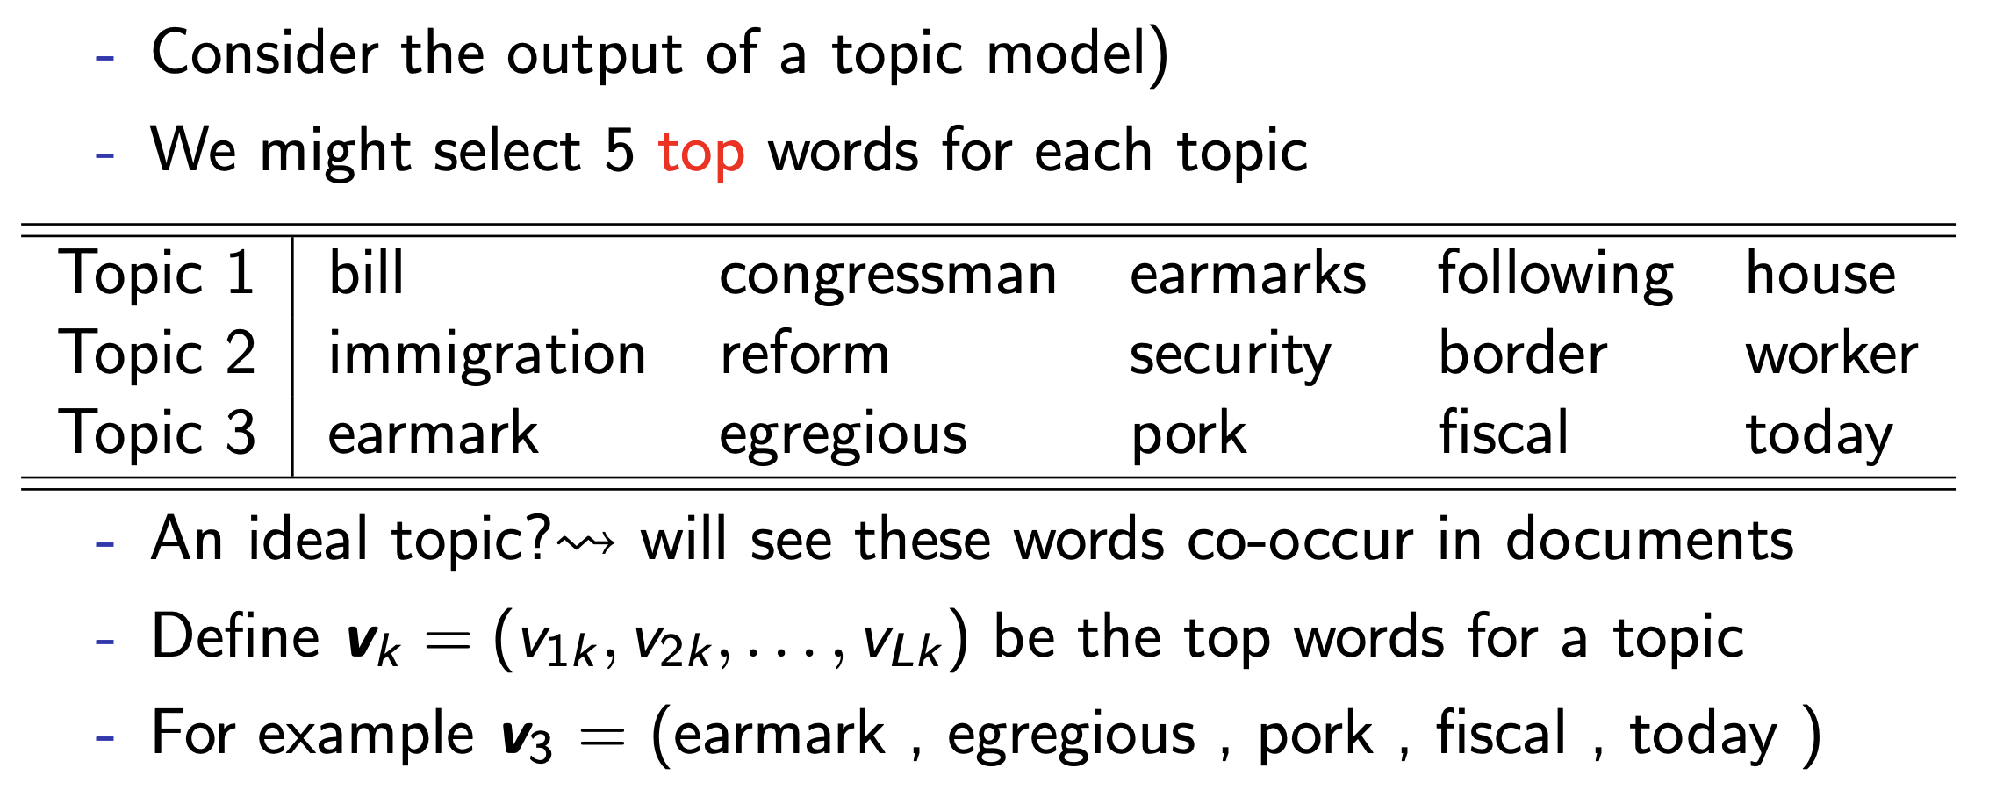
Topic Cohesiveness (Coherence)

Slide 22
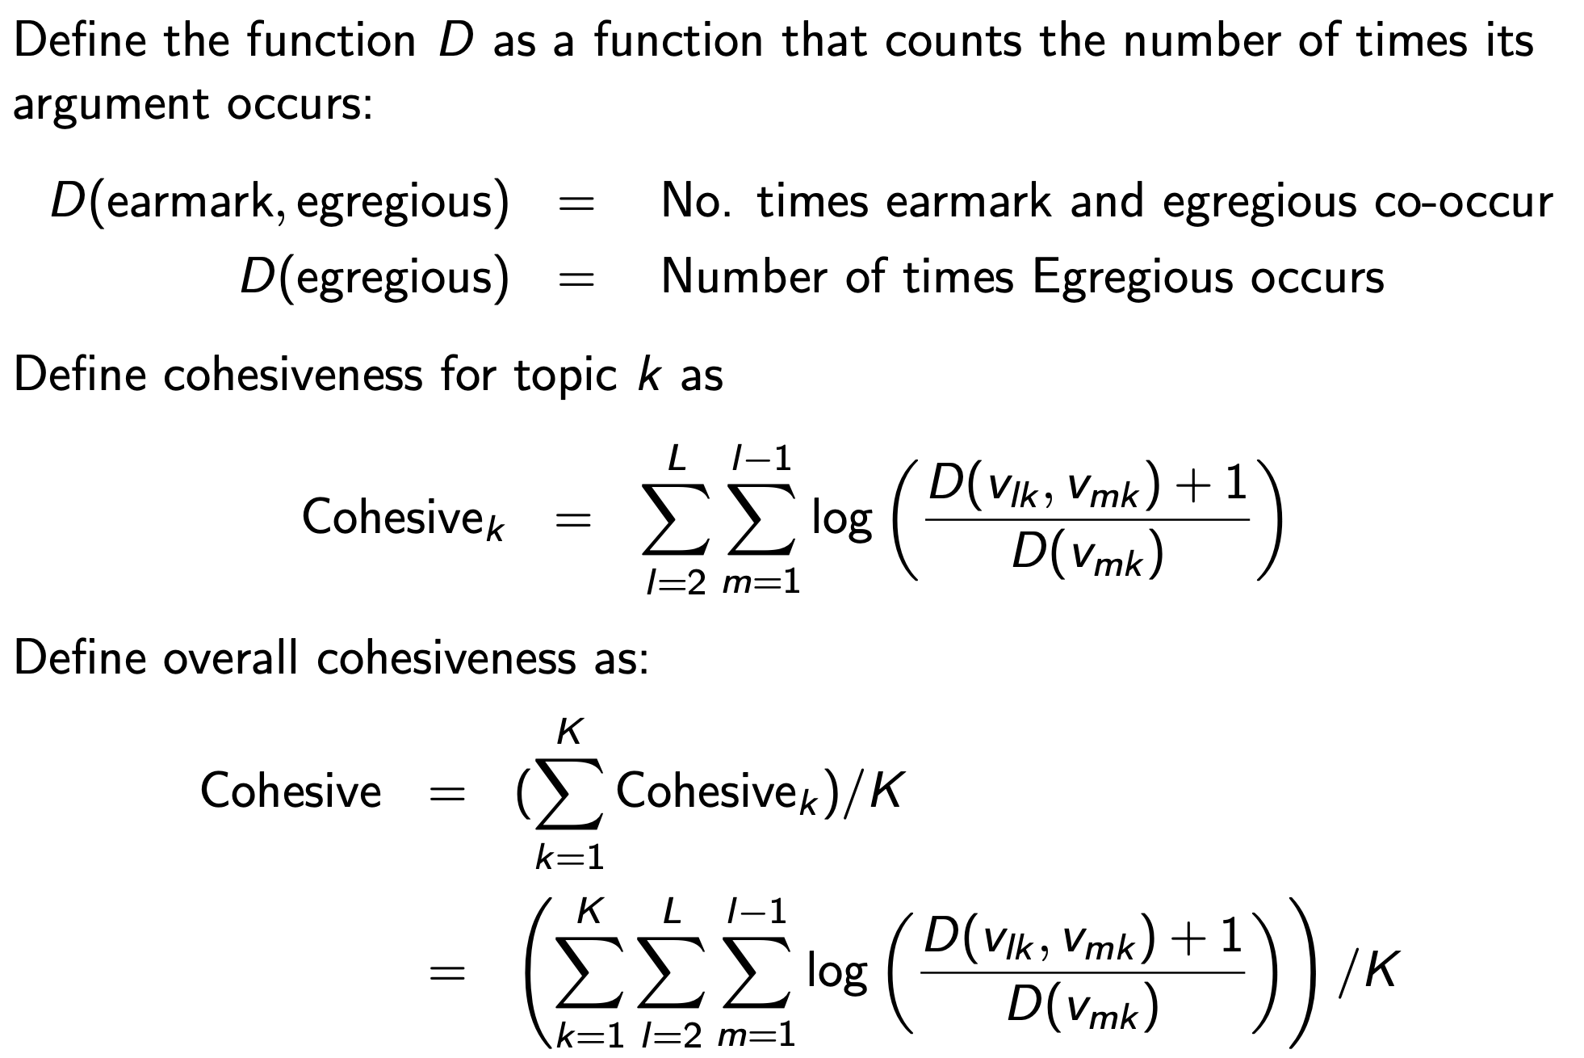
Topic Cohesiveness (Coherence)

Slide 23
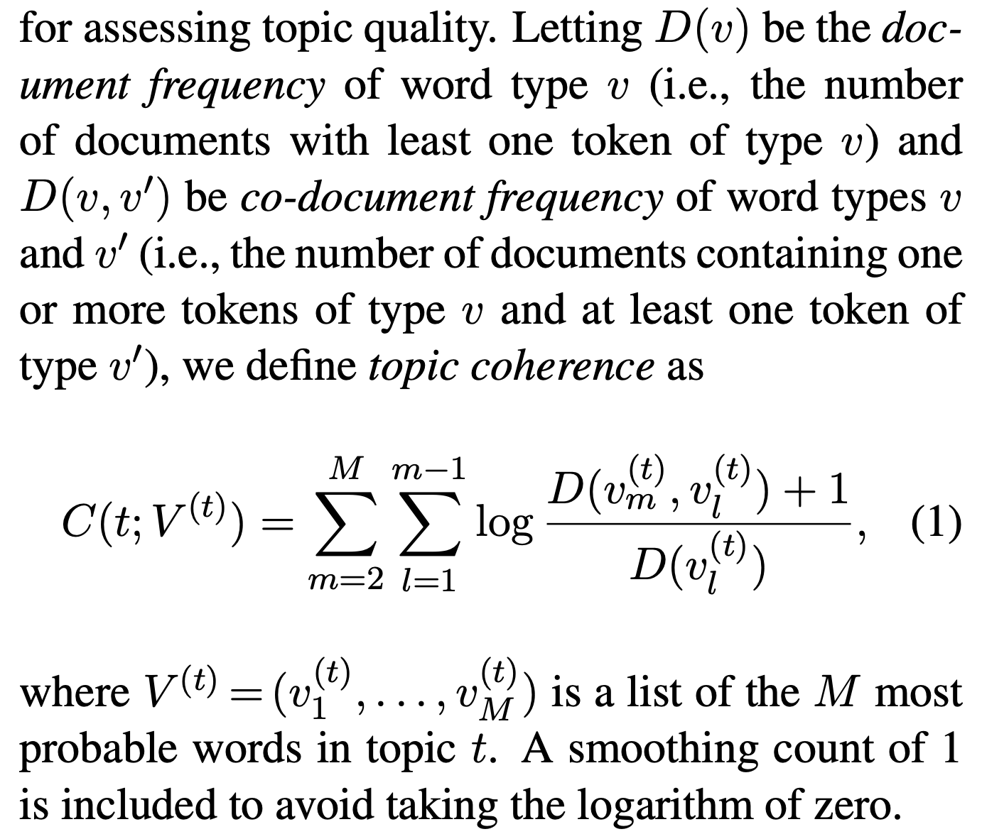
Topic Coherence
http://dirichlet.net/pdf/mimno11optimizing.pdf
Measure of the degree to which top words in topic co-occur in documents.
Maximized when all top terms always co-occur with each other.
Minimized when top terms never co-occur.

Slide 24
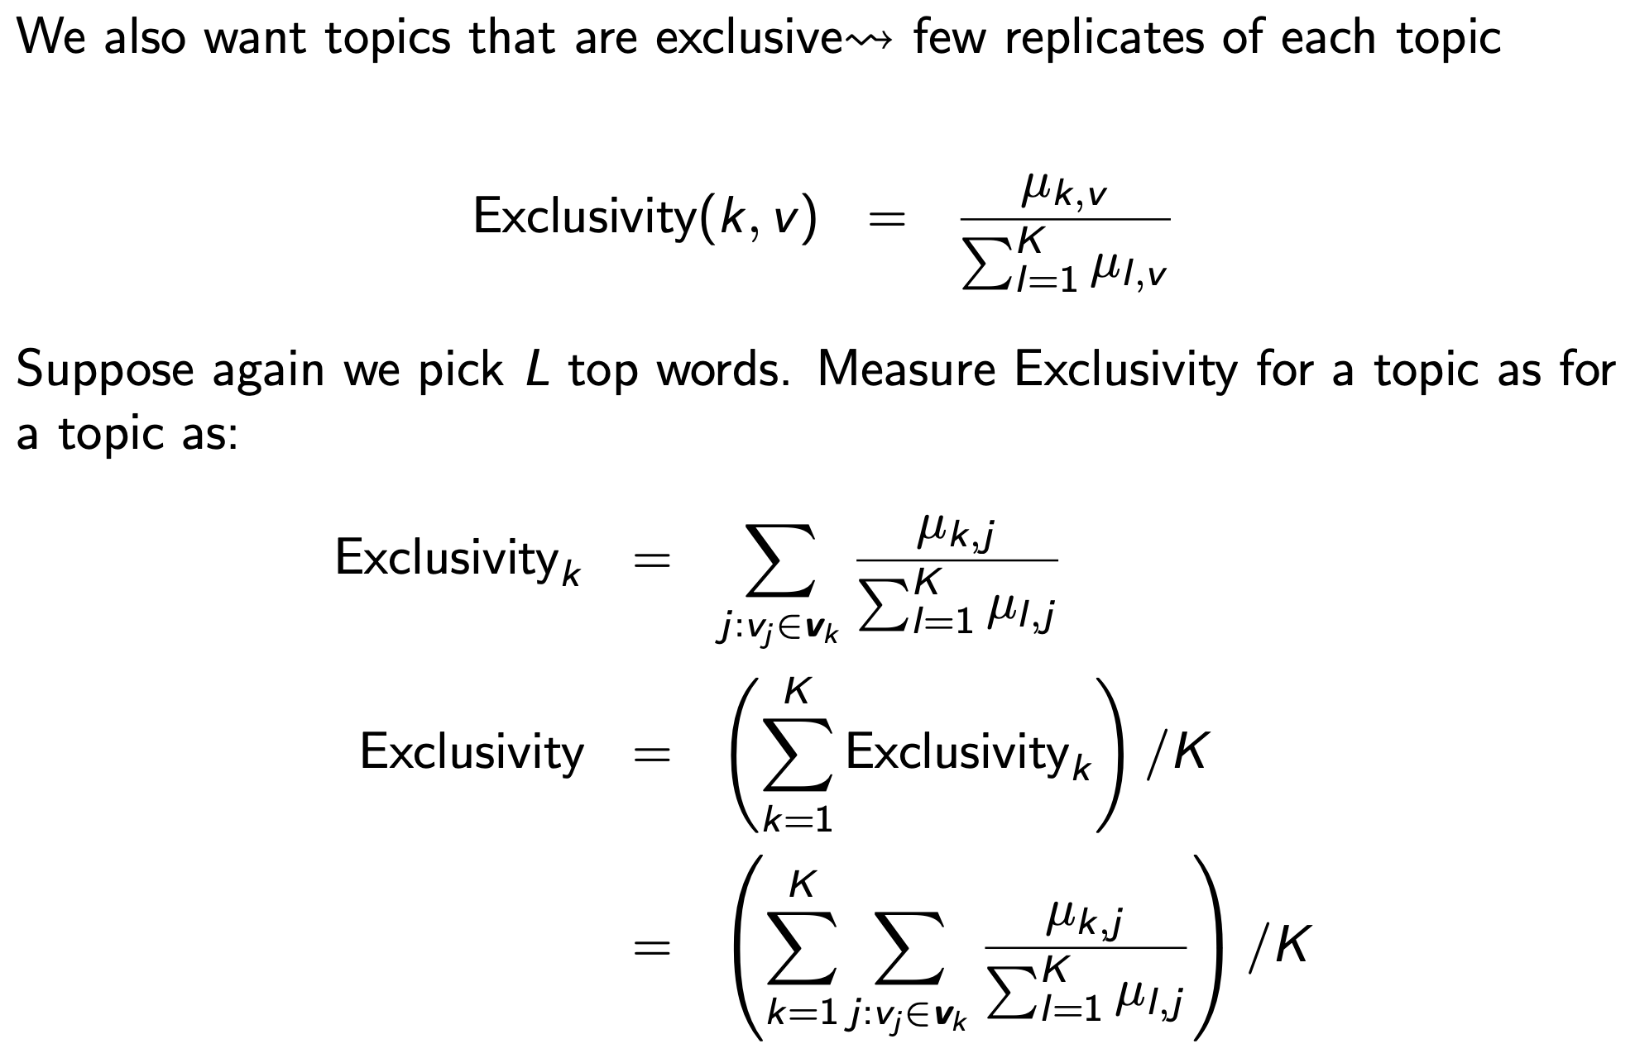
Topic Exclusivity

Slide 25
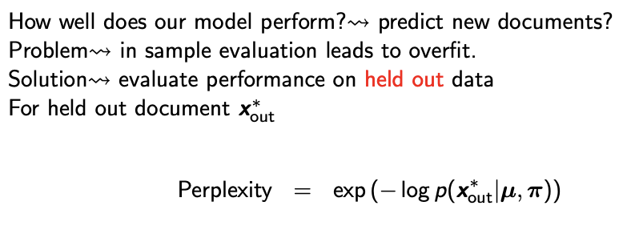
Perplexity
How well does your model fit held-out data?
Wallach et al. (2009). Evaluation methods for topic models. ICML
Left-to-right method is preferred.

Slide 26
FREX (frequency + Exclusivity) Scoring
Let w be a weight between 0 and 1 as to how much importance we place on word frequency.
Let F be the relative frequency of the given word in a given topic distribution.
Let E be the relative weight of the current topic in the distribution over topics for that word.
FREX = ((w/F) + ((1-w)/E))^-1
Increasing in word being both very common in topic and very rare in other topics.

Slide 27
Hyper-parameters + Model Performance
It is ok to refit your model, even if you are using it for measurement if you do not base decisions to refit on properties that will influence measurements (e.g. topic proportion in documents, etc.).
Can optimize for coherence + exclusivity to select # topics.
Use Geweke test + look at chain to determine convergence.
Many automated metrics (esp. Perplexity) will prefer large number of topics.
preText for sensitivity analysis once you have final specification.
My take: no hard and fast rules. Want to combine domain expertise (READ DOCUMENTS) + theory + metrics to pick between a few specifications + sensitivity analysis.

Slide 28
Sensitivity, Reliability, Interpretability
Specification + Sensitivity Analysis
How does varying preprocessing, hyperparameters change results.
Do you have a strong theory about why you chose the parameters you did?
For those you did not have a strong theory for, sensitivity analysis.
Reliability
Make sure to set your random seed + save replication materials so others can exactly replicate your results.
Intercoder reliability → analogue is same results across multiple seeds.
Interpretability
Can you draw conclusions from your results? Do topics map on to constructs you care about?
Do high probability documents in topics actually contain that topic?

Slide 29
Validity
﻿Semantic validity: the extent to which each category or document has a coherent meaning and the extent to which the categories are related to one another in a meaningful way.
﻿Convergent construct validity: the extent to which the measure matches existing measures that it should match.
﻿Discriminant construct validity: the extent to which the measure departs from existing measures where it should depart.
﻿Predictive validity: the extent to which the measure corresponds correctly to external events.
﻿Hypothesis validity: the extent to which the measure can be used effectively to test substantive hypotheses.

Slide 30
Validation – My Take
﻿Start with a plan: document the steps you take in data preparation in analysis. Have reasons/theory for your modelling choices. Tell your reader when things did not work. Set your seed!
﻿Use hyper-parameter optimization: where possible, allow the model to learn optimal hyper-parameters to reduce researcher input.
Make sure model has converged before interpretation.
Engage in some validation efforts.
How you validate depends on your measurement goals, what metadata you have available. Do not need to do everything from Quinn et al., (2010).
Interpretation checks: make sure you look at a sample of high probability documents in topics of interest to make sure they are actually about that topic. Read enough of corpus to come to qualitative judgement about model quality.

